Slide 1
Sonic lore
By chaphidoesstuff

Slide 2
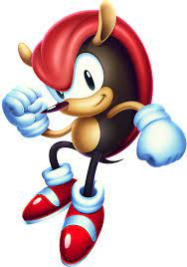
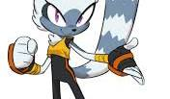

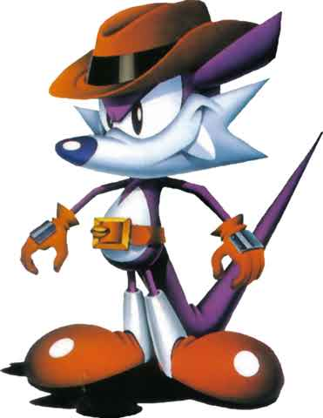
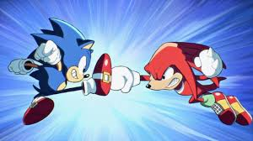
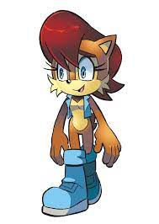
Sonic’s species
Big animal like creatures usually referred to as Mobians and Nermies, content like the game Sonic Riders states that certain races of them (Bird ones) having extraterrestrial origins. They are split into races based on real animals, they are the focus of the sonic series and live alongside humans.

Slide 3


Chaos Emeralds and the master emerald
Magic rocks from an unknown origin, they are quartz gemstones that power machines and mutate animals, giving the main cast the ability to become super as long as they keep collecting rings. The master emerald is a separate gem that can power or neutralise the chaos emeralds

Slide 4


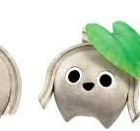
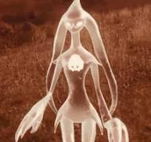
Ancients
The Ancients came to earth after their home planet was destroyed by an entity called the end, they were led there by the chaos emeralds. They were followed by the end where they sealed its consciousness into their technology along with themselves leaving remnants of themselves as stone creatures called koco, a group managed to escape to an island knows

Slide 5
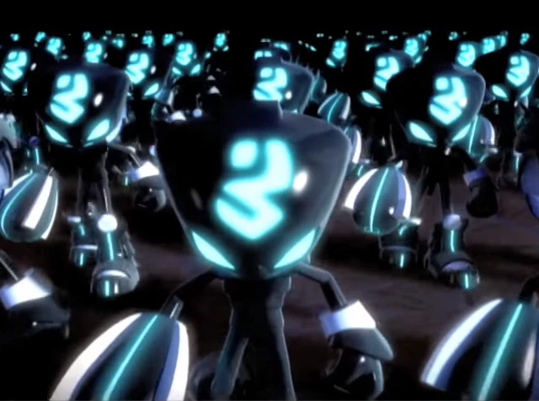
Echidna tribes

